Slide 1
Tutorial 3- UML class diagram

Slide 2
Outline
2.1 | Introduction to OO Methodologies :Booch,Rambaug and Jacobson
2.2 | Requirements Engineering Tasks, Requirement Elicitation Techniques, Software Requirements: Functional, Non-Functional, Domain Bernd Bruegge Chapter 4

Slide 3
Outline
2.3 | Requirements Characteristics, Requirement qualities, Requirement Specification, Requirement Traceability, System Analysis Model Generation, Requirement Prioritization, Documentation : Use Case Diagram,Acitvity DiagramBernd Bruegge Chpater 4 & Chpater 2
2.4 | Categorizing classes: entity, boundary and control ,Modeling associations and collections-Class Diagram
2.5 | Dynamic Analysis - Identifying Interaction – Sequence and Collaboration diagrams, State chart diagram

Slide 4
Object Oriented Process
The Object Oriented Methodology of Building Systems takes the objects as the basis.
First the system to be developed is observed and analyzed and the requirements are defined as in any other method of system development.
Objects are identified.
Example: Banking System: customer is an object.

Slide 5
Object Oriented Process
Object Modeling is based on identifying the objects in a system and their interrelationships.
The basic steps of system designing using Object Modeling may be listed as:
System Analysis
System Design
Object Design
Implementation

Slide 6
Class and Object
The concepts of objects and classes are intrinsically linked with each other and form the foundation of object–oriented paradigm.
An object is a real-world element in an object–oriented environment that may have a physical or a conceptual existence.
Object is an entity that has identity , state and behavior.

Slide 7
Class and Object
Objects can be modeled according to the needs of the application. An object may have a physical existence, like a customer, a car, etc.; or an intangible conceptual existence, like a project, a process, etc.
A class represents a collection of objects having same characteristic properties that exhibit common behavior.
Creation of an object as a member of a class is called instantiation. Thus, object is an instance of a class.

Slide 8
Requirement Elicitation (Gathering)
A requirement is a feature that the system must have or a constraint that it must satisfy to be accepted by the client.
Requirements engineering aims at defining the requirements of the system under construction.
Requirements engineering includes two main activities:
requirements elicitation: specification of system that client understands.
Analysis: analysis model that developers can interpret.

Slide 9
Requirement Elicitation
Requirements elicitation is about communication among developers and users to define a new system.
Failure to communicate and understand each others - system fails
Errors introduced during requirements elicitation are expensive to correct, as they are usually discovered late in the process, often as late as delivery.

Slide 10
Requirement Elicitation
Requirements elicitation methods aim at improving communication among developers, clients, and users.
Requirement Specification: The client, the developers, and the users identify a problem area and define a system that addresses the problem.

Slide 11
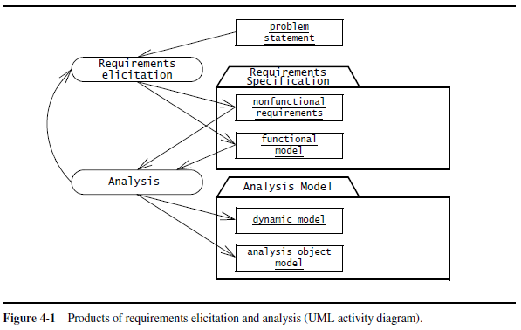

Slide 12
Requirements Elicitation Activities
1. Identifying actors: developers identify the different types of users the future system will support.
2. Identifying scenarios:
developers observe users and develop a set of detailed scenarios (concrete examples of future systems) for typical functionality provided by the future system.
Scenarios used for understanding application domain in detail.

Slide 13
Requirements Elicitation Activities
3. Identifying use cases:
Once developers and users agree on a set of scenarios.
Set of use cases are derived from scenarios that represent future systems.
Use cases are abstractions describing all possible cases of the system

Slide 14
Requirements Elicitation Activities
4. Refining use cases:
requirements specification is complete by detailing each use case.
describing the behavior of the system in the presence of errors and exceptional conditions.

Slide 15
Requirements Elicitation Activities
5. Identifying relationships among use cases:
identify dependencies among use cases.
Consolidate(combine) the use case model by factoring out common functionality.

Slide 16
Requirements Elicitation Activities
Identifying nonfunctional requirements:
developers, users, and clients agree on aspects that are visible to the user, but not directly related to functionality.
These include constraints on the performance of the system, its documentation, the resources it consumes, its security, and its quality.

Slide 17
Requirement Elicitation Techniques
Questionnaires: Asking the end user a list of pre-selected questions
Task Analysis: Observing end users in their operational environment
Scenarios: Describe the use of the system as a series of interactions between a concrete end user and the system
Use cases: Abstractions that describe a class of scenarios.

Slide 18
Functional Requirements
Functional requirements describe the interactions between the system and its environment independent of its implementation.
Does not focus on implementation details.
Example: SatWatch, a watch that resets itself without user intervention

Slide 19
Non-Functional Requirements
Nonfunctional requirements describe aspects of the system that are not directly related to the functional behavior of the system.
Usability to performance - non functional requirements

Slide 20
Non-Functional Requirements (Types)
1. Usability is the ease with which a user can learn to operate or use system.
Usability requirements: online help or user level documentation , manual etc.
Clients can set usability issues for developer for example – color scheme for GUI

Slide 21
Non-Functional Requirements
2. Reliability is the ability of a system or component to perform its required functions under stated conditions for a specified period of time.
Reliability is replaced with dependability which includes other features like robustness and safety

Slide 22
Non-Functional Requirements (Types)
3. Performance requirements are concerned with quantifiable attributes of the system such as:
Response Time
Throughput
Availability
Accuracy

Slide 23
Non-Functional Requirements (Types)
4. Supportability requirements are concerned with the ease of changes to the system after deployment.
Adaptability: the ability to change the system to deal with additional application domain concepts.
Maintainability: the ability to change the system to deal with new technology or to fix defects.
Internationalization: the ability to change the system to deal with additional international conventions, such as languages, units, and number formats

Slide 24
Additional Non-functional Requirements
Implementation requirements
constraints on the implementation of the system.
specific tools, programming languages, or hardware platforms.
Interface requirements
are constraints imposed by external systems
interchange formats

Slide 25
Requirements Characteristics
Requirements are continuously validated with the client and the user.
Requirement validation involves checking that the specification is complete, consistent, unambiguous, and correct.

Slide 26
Requirements Characteristics
4. Correct: represents accurately the system that the client needs and that the developers intend to build.
Correct—The requirements describe the features of the system and environment of interest to the client and the developer, but do not describe other unintended features.

Slide 27

Use Case Diagrams
Identifying Actors
Actors represent external entities that interact with the system.
An actor can be human or an external system.
Actor

Slide 28
Use Case Diagrams
Give meaningful business relevant names for actors.
Primary actors should be to the left side of the diagram –highlight the important roles in the system.
Actors model roles (not positions) – In a hotel both the front office executive and shift manager can make reservations. “Reservation Agent” actor name to highlight the role.
External systems are actors – If your use case is send email and if interacts with the email management software then the software is an actor to that particular use case.
Actors don’t interact with other actors
Place inheriting actors below the parent actor

Slide 29
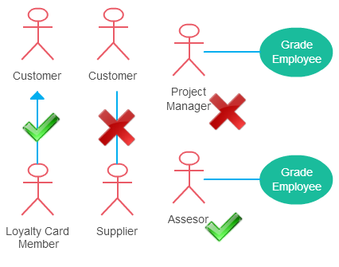

Slide 30
Use Case Diagram
Once the actors are identified, the next step in the requirements elicitation activity is to determine the functionality that will be accessible to each actor.
Use cases are external (user) view of a system
Intended for modeling dialogue between user and system

Slide 31
Use Case Diagram
Identifying Scenarios
A scenario is a narrative description of what people do and experience as they try to make use of computer systems and applications.
Scenario is description of the system from single actor’s or user’s point of view.
Scenarios may be defined for current , future , evaluation or training phases of the software development process.

Slide 32
Use Case Diagram
Identifying Use Cases
Use cases represent what the actors want your system to do for them.
A use case represents a complete flow of events through the system.
A Use Case captures some actor-visible function
- Achieves some discrete (business-level) goal for that actor
- May be read, write, or read-modify-write in nature

Slide 33
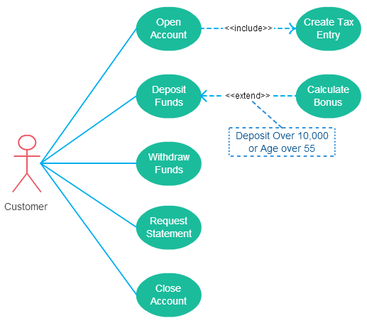

Slide 34
Elements of use case diagram: Actor
Actor

Slide 35
Elements of use case diagram: Use Case
System function (process – automated or manual).
Use Case
Do Something (Operation)

Slide 36
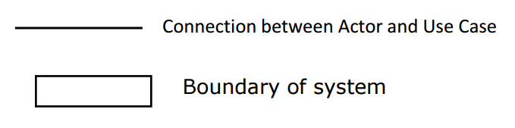
Elements of use case diagram

Slide 37
There can be 5 relationship types in a use case diagram.
Association between actor and use case
Generalization of an actor
Extend between two use cases
Include between two use cases
Generalization of a use case

Slide 38
Association Between Actor and Use Case
This one is straightforward and present in every use case diagram.
An actor must be associated with at least one use case.
An actor can be associated with multiple use cases.
Multiple actors can be associated with a single use case.

Slide 39
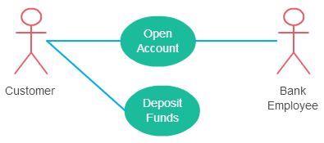
Association Between Actor and Use Case

Slide 40
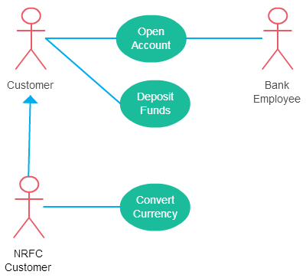
Generalization of an Actor
Generalization of an actor means that one actor can inherit the role of an other actor.

Slide 41
Extend Relationship Between Two Use Cases
It extends the base use case and adds more functionality to the system.
The extending use case is dependent on the extended (base) use case.
The extending use case is usually optional and can be triggered conditionally.
The extended (base) use case must be meaningful on its own.
Arrow points to the base use case when using <<extend>>
Extending use case is optional

Slide 42
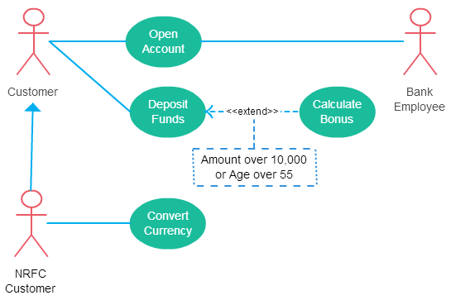

Slide 43
Include Relationship Between Two Use Cases
Include relationship show that the behavior of the included use case is part of the including (base) use case.
The base use case is incomplete without the included use case.
The included use case is mandatory and not optional.
Like a “use case subroutine”

Slide 44
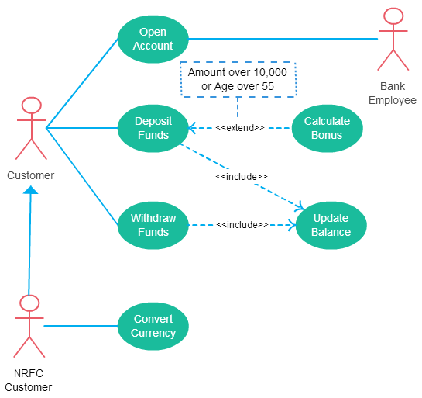

Slide 45
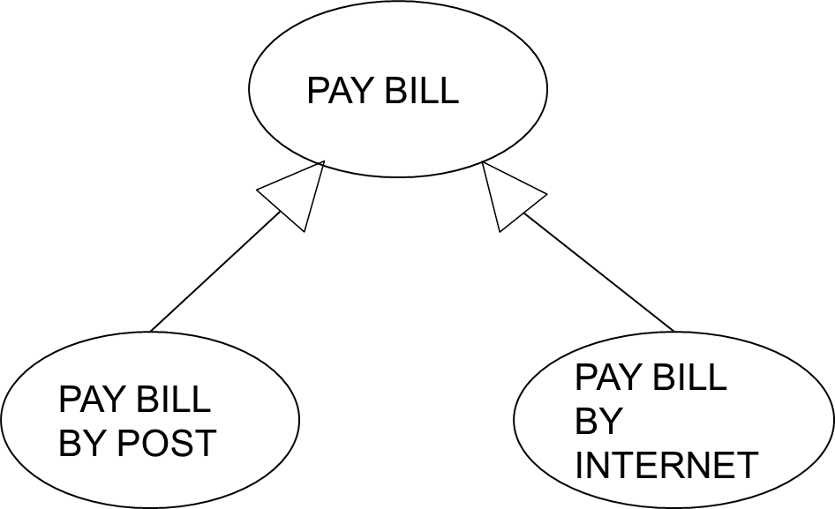
Generalization of a Use Case
This is similar to the generalization of an actor.
This is used when there are common behavior between two use cases and also specialized behavior specific to each use case.

Slide 46
PROBLEM DEFINTION-VENDING MACHINE
A vending machine accepts coins for a variety of products. The user selects the drink from products available through the selection panel. If the drink is available the price of the product is displayed. The user the deposits the coins depending on the price of the product. Coin collector collects the coins. After stipulated time, the controller will compare the deposited coins with the price, If the amount deposited is less than the price then error message will be displayed and all deposited coins will be dispensed by coin dispenser else the drink will be dispensed by the product dispenser. Draw use case diagram.

Slide 47
Use Case Diagram for Vending Machine
Actor- User
Processes involved in the system
Select product
Deposit coins
Verify the deposited amount
Dispense product
Dispense coins

Slide 48
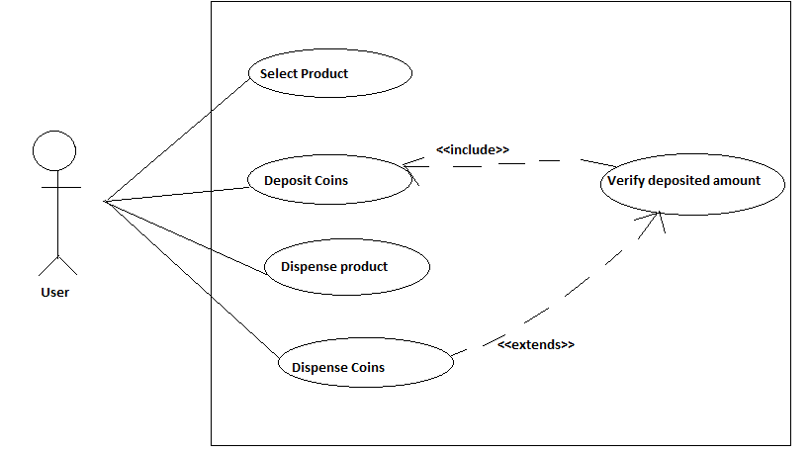

Slide 49
Use Case Example
Customer (actor) uses bank ATM to Check Balances of his/her bank accounts, Deposit Funds, Withdraw Cash and/or Transfer Funds (use cases). ATM Technician provides Maintenance and Repairs. All these use cases also involve Bank actor whether it is related to customer transactions or to the ATM servicing.

Slide 50
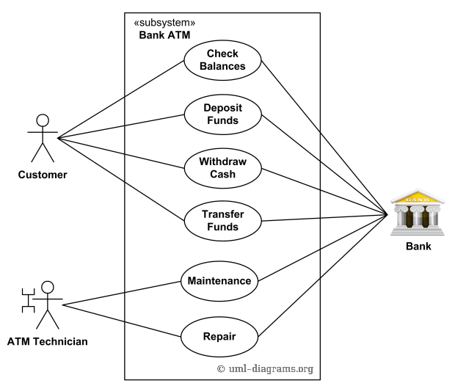

Slide 51
Use Case Example
On most bank ATMs, the customer is authenticated by inserting a plastic ATM card and entering a personal identification number (PIN). Customer Authentication use case is required for every ATM transaction so we show it as include relationship. Including this use case as well as transaction generalizations make the ATM Transaction an abstract use case. Customer may need some help from the ATM. ATM Transaction use case is extended via extension point called menu by the ATM Help use case whenever ATM Transaction is at the location specified by the menu and the bank customer requests help, e.g. by selecting Help menu item.

Slide 52
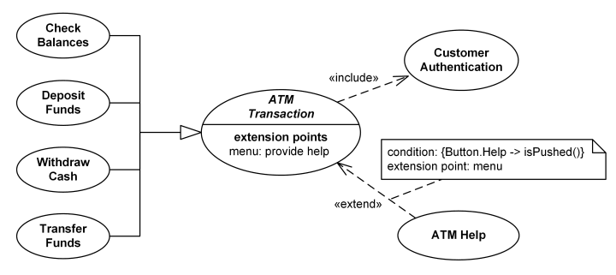

Slide 53
Use Case Example
ATM Technician maintains or repairs Bank ATM. Maintenance use case includes Replenishing ATM with cash, ink or printer paper, Upgrades of hardware, firmware or software, and remote or on-site Diagnostics. Diagnostics is also included in (shared with) Repair use case.

Slide 54
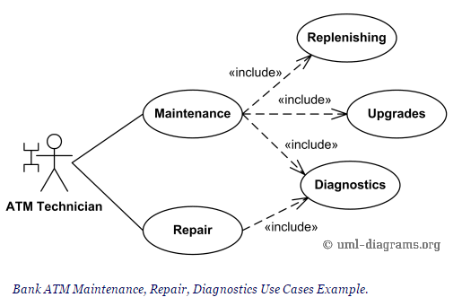

Slide 55
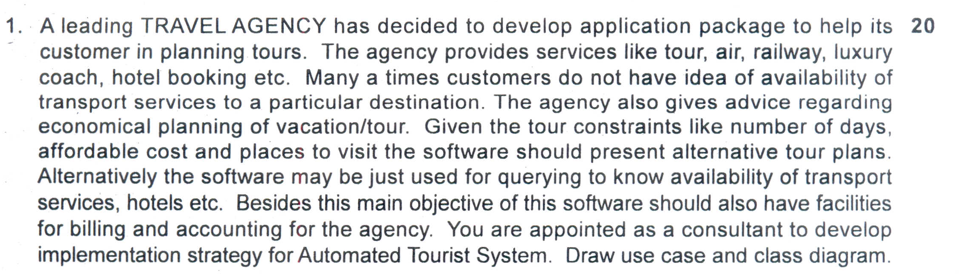

Slide 56
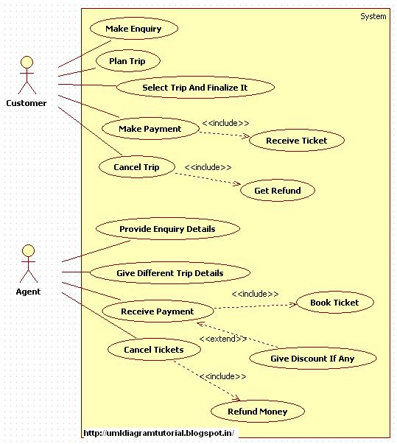

Slide 57
USE CASE
Online Airline Reservation System

Slide 58
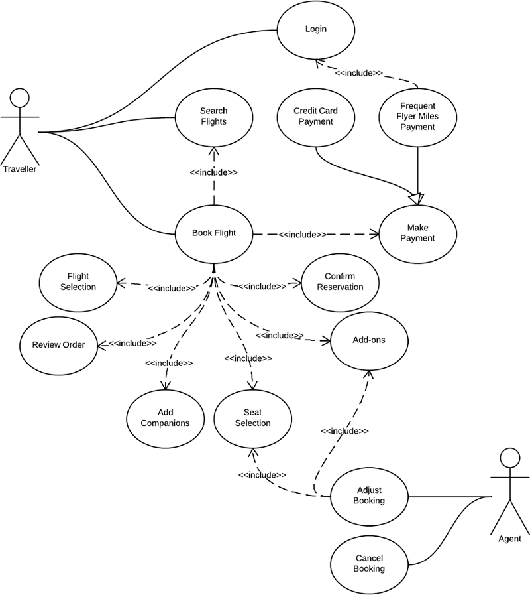

Slide 59
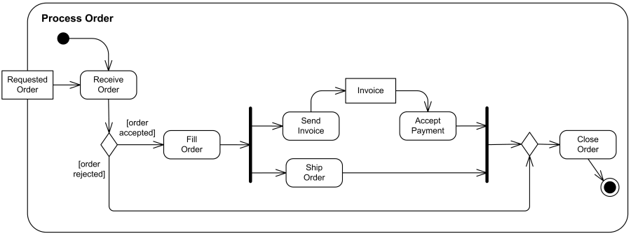
An example of business flow activity to process purchase order.

Slide 60
